Slide 1

BC3409 AI in Accounting and Finance Lecture 2: Neural Network
Teoh Teik Toe
ITOM/NBS
ttteoh@ntu.edu.sg
Aug 2020
97905202

Slide 2
Video Recording
Regression (PA) – Video : https://www.dropbox.com/sh/dcz4m1ps91mimzz/AACBicbA3-KABogiJ3iWu5N9a?dl=0
Decision Tree (PA) – Video: https://www.dropbox.com/sh/lsjq0p395b9v3hz/AAC5N_k1s4gX-2m4xdjJ25Tka?dl=0
Text Analytics – Video : https://www.dropbox.com/sh/h5j15ofjyz474cs/AADjDlUhUO4cutjCCqxvY3mLa?dl=0

Slide 3
Weekly Plan
Introduction to AI & Installing Python and R
Neural Network 1 (PA)
Neural Network 2 (PA)
Weka (PA & Project)
Chatbot 1 (Project)
Chatbot 2 (Project)
RPA 1 (Project)
RPA 2 (Project)
Practical Assessment Review
E-learning Week?
Block Chain (Not Assessable)
Deep Learning – Tensor Flow LSTM GAN & Reinforcement Learning (Not Assessable)
Project Presentation

Slide 4
Objective of this class – Domain Knowledge
Analytics
Prediction
Automation

Slide 5
Objective of this class – Skill Knowledge
Neural Network
Chatbot
RPA

Slide 6
E-Learning Week
To Be Confirm

Slide 7
Consultation
S3 B2 C110
65148988/97905202/ttteoh@ntu.edu.sg
Wednesday 130pm to 330pm
Optional (by Appointment)
Tuesday 11am to 1pm
Thursday 11am to 1pm
Or any other timing

Slide 8
Most Importantly …..
Component | Weightage | Team/Individual
Class Participation | 15 | Individual | Week 1 to 13
Practical Assessment | 40 | Individual | Week 10
Individual Project | 30 | Individual | Week 11 (Video Clip)
Group Project & Presentation | 15 | Team | Week 13 (Video Clip & 15 mins Presentation for each group)
Total | 100%

Slide 9
Mark Distribution
Participation 15%
Discussion 5%
Chatbot Presentation 5% (Week 6)
RPA Presentation 5% (Week 8)
Individual Project 30%
Project Plan 5% (Week 5)
Final Report 20% (Week 12)
Group Project 15%
Project Plan 5% (Week 9)
Final Report 10% (Week 13)
Practical Assessment 40% (Week 10)

Slide 10
Individual and Group Project
Prediction
Analytics
Dashboard
Chatbot
RPA
Data source:
Kaggle
https://www.kaggle.com/c/competitive-data-science-predict-future-sales
https://www.kaggle.com/c/nlp-getting-started
Or https://www.dropbox.com/sh/2gusfymynty76wn/AACRo7xXjwHYR9f3bRlUG9gda?dl=0
Sample
https://www.dropbox.com/sh/4npxwpy2y5a8g68/AACvkV8Yo4dU9NnvCxN9ppcga?dl=0

Slide 11
Practical Assessment
You will be given a set of data
You have one week to complete
You should use neural network (regression and decision tree is optional)
Sample: https://www.dropbox.com/sh/bnlk9jz8ximdqxk/AABmvkX8rWCcFyloXmZ1CRgra?dl=0
https://www.dropbox.com/sh/ygdfp3n3rlb5m54/AABO8Wyd7Y9F_VA0zeTKwgGSa?dl=0
Overall library : https://www.dropbox.com/sh/ygdfp3n3rlb5m54/AABO8Wyd7Y9F_VA0zeTKwgGSa?dl=0

Slide 12
Practical Assessment
Practical Assessment Deliverables:
A concise report in ppt or word document format, with a one to two page executive summary, of your most important findings. Guideline: Approximately 20 pages, excluding appendices and executive summary.
The R/Python or other programming script used to execute the analytics. Also provide the screenshots of the software and settings used. Show enough such that another independent group of researchers can reproduce and verify your findings.
Please attached the data used (.csv).

Slide 13
Objective
The difference between Regression, Decision Tree and Neural Network
Intro to Neural Network
NN using R

Slide 14
Difference between Regression, Decision Tree and Neural Network

Slide 15
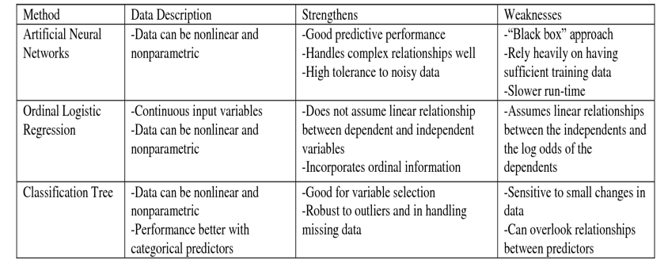
Comparison

Slide 16
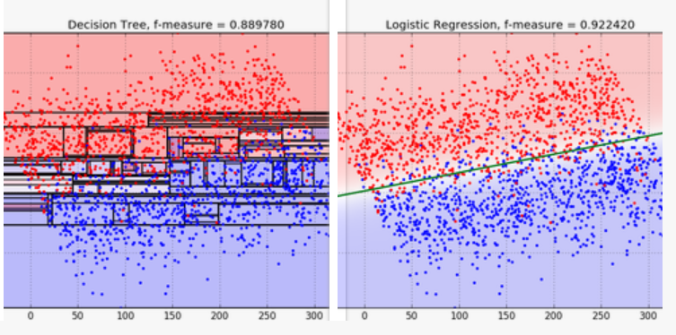
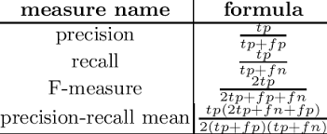
When is regression better than decision tree
https://blog.bigml.com/2016/09/28/logistic-regression-versus-decision-trees/#:~:text=Decision%20Trees%20bisect%20the%20space,generalize%20to%20planes%20and%20hyperplanes.

Slide 17
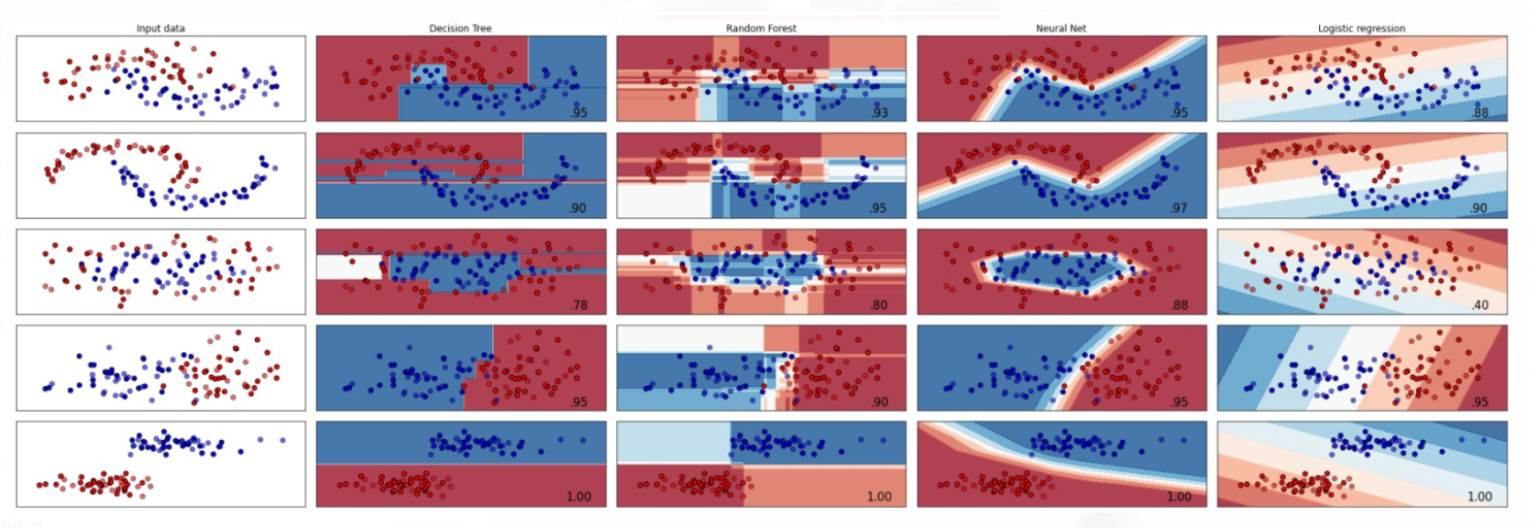
Regression, decision tree and NN

Slide 18
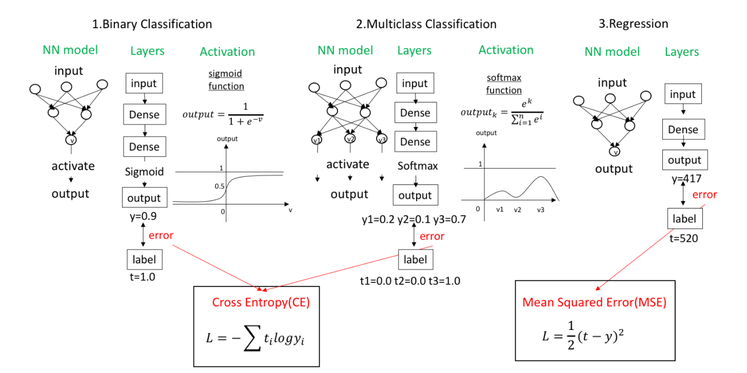
Loss Function

Slide 19
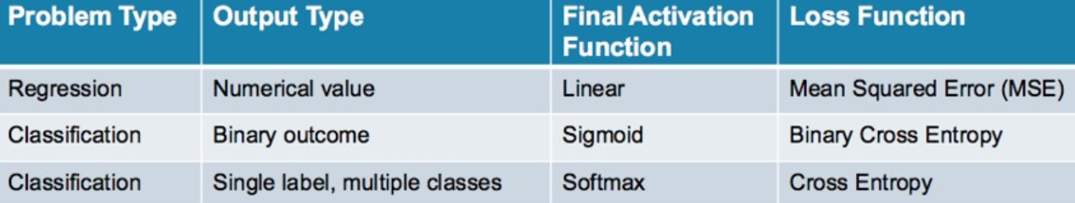
Loss Function

Slide 20
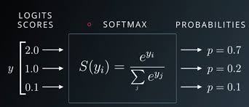
SoftMax

Slide 21
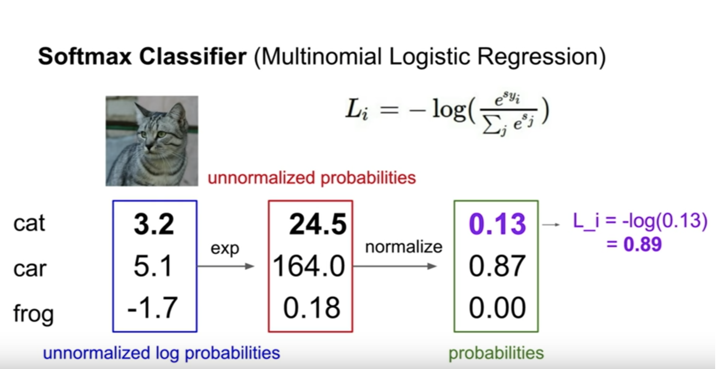
SoftMax

Slide 22
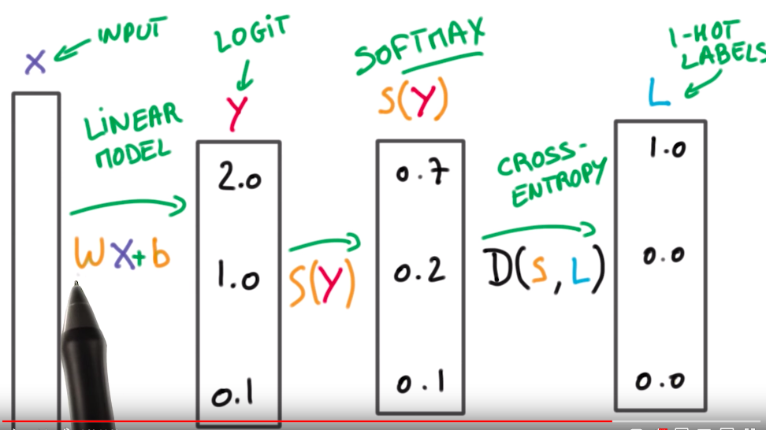
Cross Entropy

Slide 23
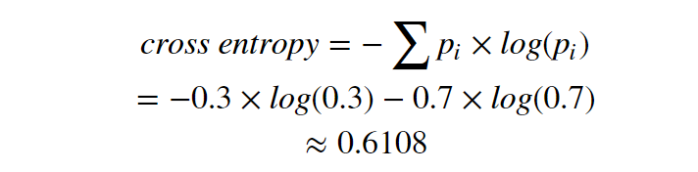
Entropy vs Cross Entropy Example
For Decision Tree
For NN
Binary (Male 1 Female 0)
0.5M 0.5F => -1xlog(0.5) – (1-1)xlog(1-0.5) = 1
0.7M 0.3F => -1xlog(0.7) + -(1-1)xlog(1-0.7)=0.514
1M 0F => -1log(1) – 0log(0) = 0 (Perfect)
Looks like Gini Index?

Slide 24
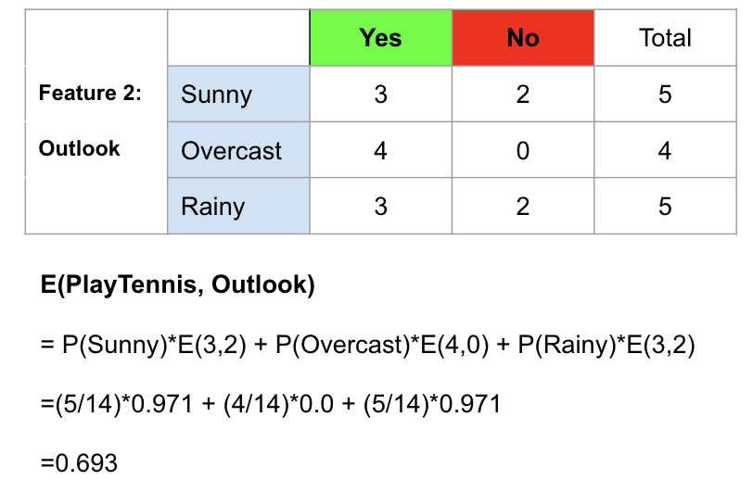
Another example: Weather and Tennis

Slide 25
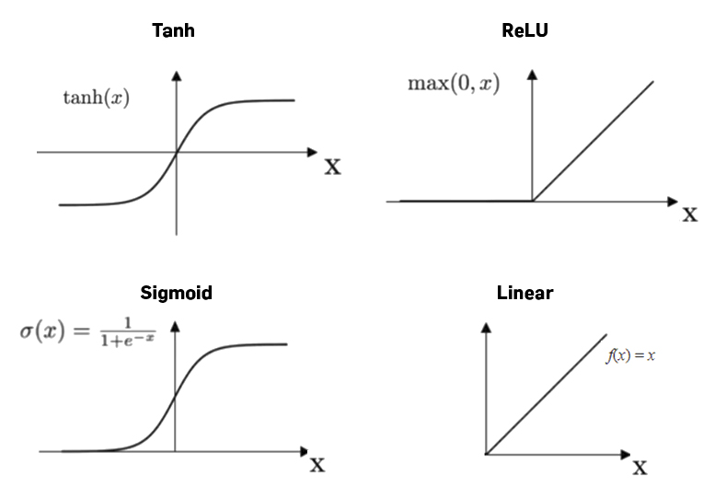
Activation Function

Slide 26
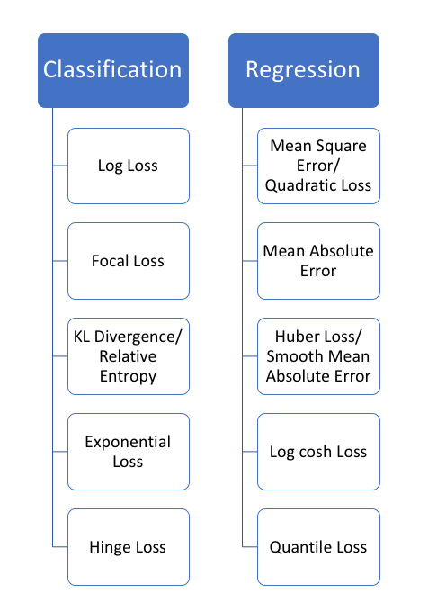
Error Function

Slide 27
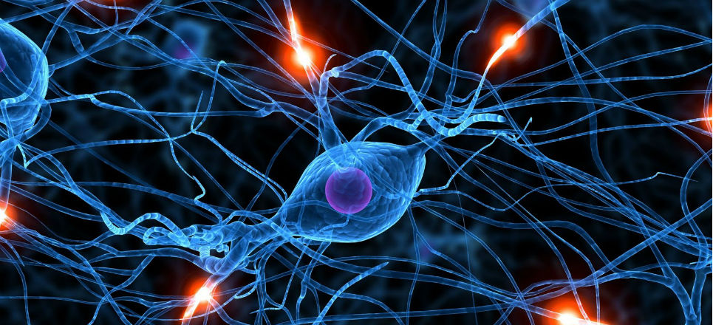
Neural Network
To model how the human brain “thinks”
Neurons (nerve cell) exist in the human brain to make sense of signals
Neurons are connected by synapses to receive and pass signals.

Slide 28

What is a neuron
https://www.alamy.com/vector-illustration-of-structure-of-human-neuron-and-healthy-human-brain-funny-educational-illustration-for-kids-isolated-characters-image246151559.html

Slide 29
Perceptron Example
2
.5
1
.3
=-1
2(0.5) + 1(0.3) + -1 = 0.3
Learning Procedure:
Randomly assign weights (between 0-1)
Present inputs from training data
Get output O, measure the difference, adjust weights
Repeat; stop when no errors, or enough epochs completed

Slide 30
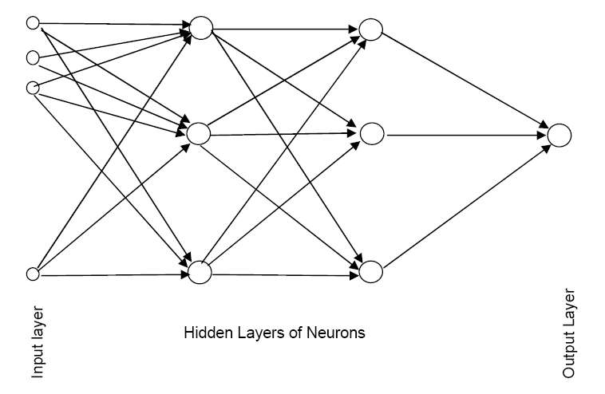
Schematic Diagram (with 2 hidden layers)

Slide 31
What Is A Hidden Layer?
The introduction of hidden layers make neural networks superior to most of the machine learning algorithms.
Hidden layers reside in-between input and output layers and this is the primary reason why they are referred to as hidden.
The word “hidden” implies that they are not visible to the external systems and are “private” to the neural network.

Slide 32
Network Structure
Multiple layers
Input layer (raw observations) [only 1]
Hidden layer(s) to process observations [Minimum 1]
Output layer for final prediction [only 1]
Nodes within layers act as neurons.
Weights (aka coefficients) connect neurons in one layer to neurons in next layer.

Slide 33
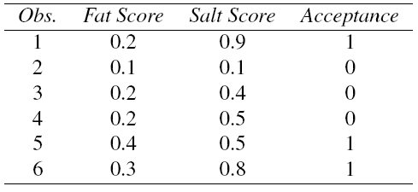
Example: Cheese Acceptance Taste Test

Slide 34
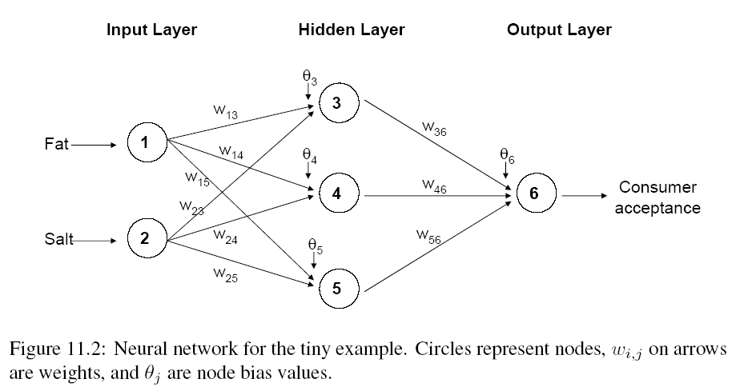
Example: Using fat & salt content to predict consumer acceptance of cheese
Neural Network schematic diagram showing weights (Ws) between two nodes in adjacent layers and intercept (aka bias) terms Өs.

Slide 35
Types of Functions
Combination (aka integration) Functions (How signals are combined into a node)
Linear
Activation Functions (How signals are processed and then transmitted out of a neural node)
Linear
Exponential
Logistic/ Sigmoidal

Slide 36
Preprocessing Steps
Scale variables to [0, 1] or [-1, 1] or z-score.
Categorical variables
If equidistant categories, map to equidistant interval points in 0-1 range
Otherwise, create dummy variables

Slide 37
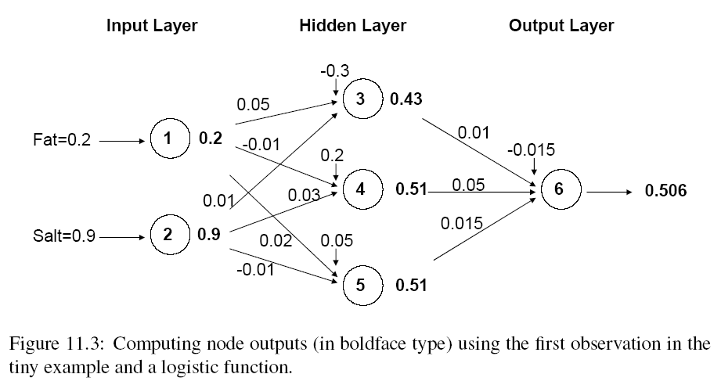
Initial Pass of the Network (focus on node 3)
Bias, equivalent to β₀
Output values after activation function
Weights (initial)
Node 3 receives two incoming signals with weights 0.05 and 0.01, process it via logistic activation function and then output the result 0.43.

Slide 38
Output of Node 3, where activation function g is a Logistic Function
Activation/ Transfer Function
Combination Function

Slide 39
Output Layer
The output of the last hidden layer becomes input for the output layer
If Y is categorical, use logistic function at output node.
If Y is continuous, use linear function at output node.
In this example, acceptance = 0 or 1, is categorical. Hence use logistic function.

Slide 40
The output node 6
Node 6 receives three incoming signals with weights 0.01, 0.05 and 0.015, process it via logistic activation function and then output the result 0.506.

Slide 41
Mapping the output to a classification
Final Output = 0.506
If cutoff for Y = 1 is 0.5, then the model classify the record with Prob(Y = 1) = 0.506 as “1”.

Slide 42
Initial Pass Through Network
Goal: Find weights that yield better predictions
The process we described above is repeated for all records
At each record, compare prediction to actual
Difference is the error for the output node
Error is propagated back and informed the hidden nodes so as to update their weights that will reduce the error.

Slide 43
Weights continue to be updated with next Observation thru the Network
Weights are updated after each record is run through the network
Completion of all records through the network is one epoch (also called sweep or iteration)
After one epoch is completed, return to first record and repeat the process.

Slide 44
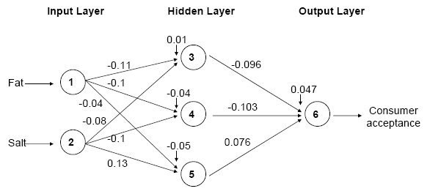
Cheese Acceptance Example: Final Weights
The final weights are optimized based on the sample, random seed and model settings, and is not unique. There could exist another model with different final weights but has the same predictive performance.

Slide 45
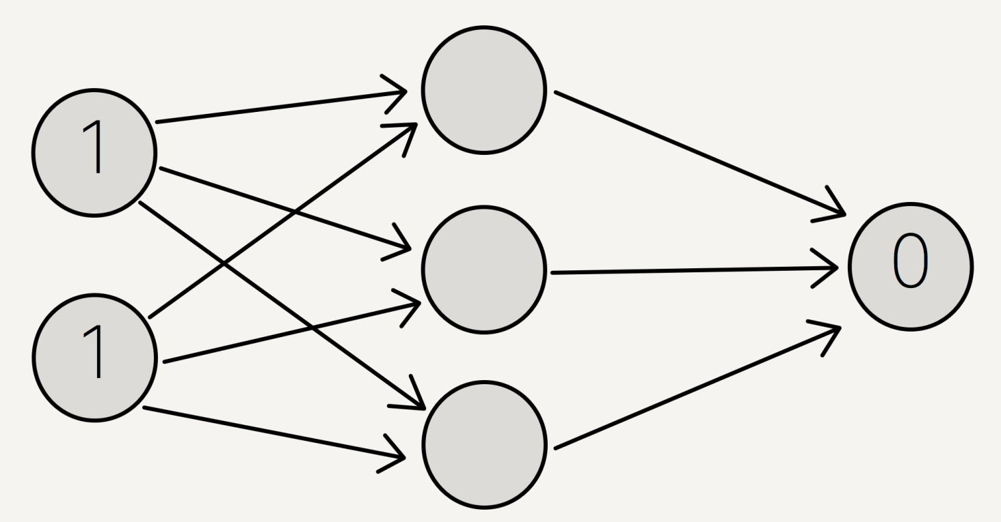
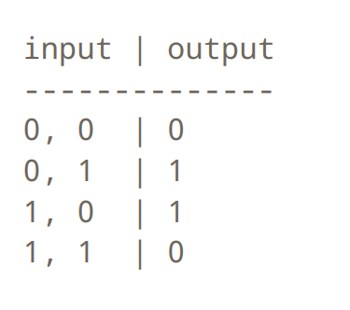
Business Example: Company Borrowing
Input 1: Size: Small=0, Big=1
Input 2: Sales: Low=0, High =1
Output : Borrowing: 0,1
Scenario:
Small Size Company and Low Sales will not borrow money - 0,0 | 0
Big Size Company and High Sales do not need to borrow money - 1,1 | 0
The rest need to borrow money
Size, Sales | Borrow
Take 1,1 | 0 for example

Slide 46
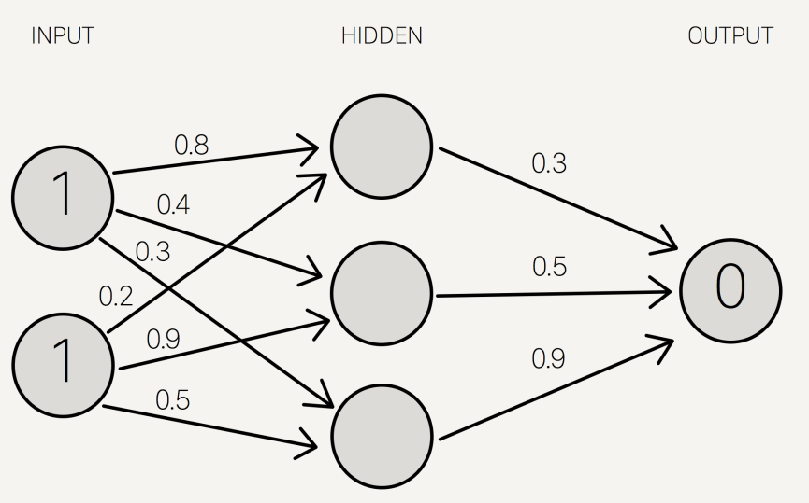
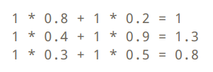
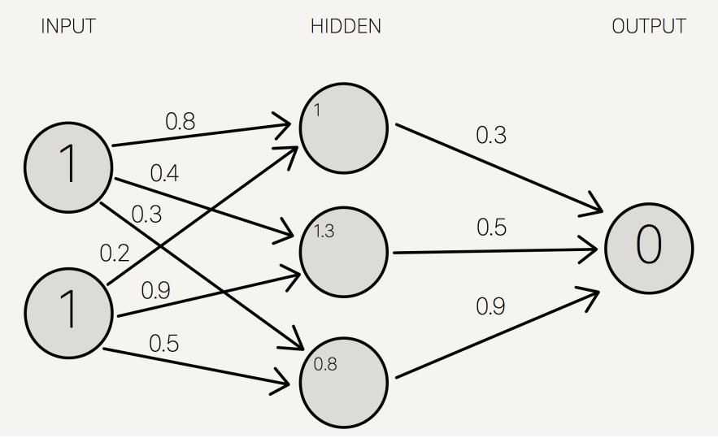
Assign Initial Random Number 0 to1
Step 1 Multiply and Summation
Note: 3

Slide 47
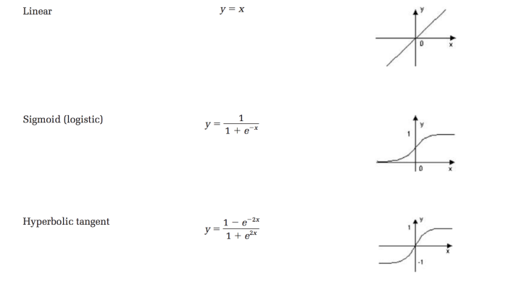
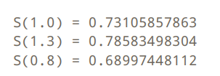
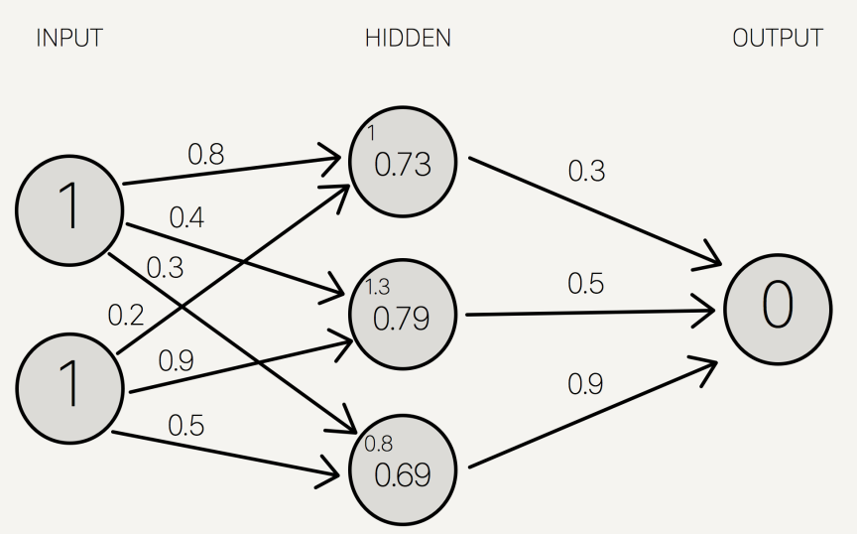
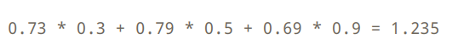
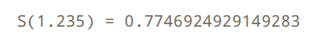
Activation Function
Step 2 Sigmoid Activation
1/(1+e^-1)=0.731
Note: 2
Step 3 Multiply and Summation
Step 4 Sigmoid
Note: 1

Slide 48
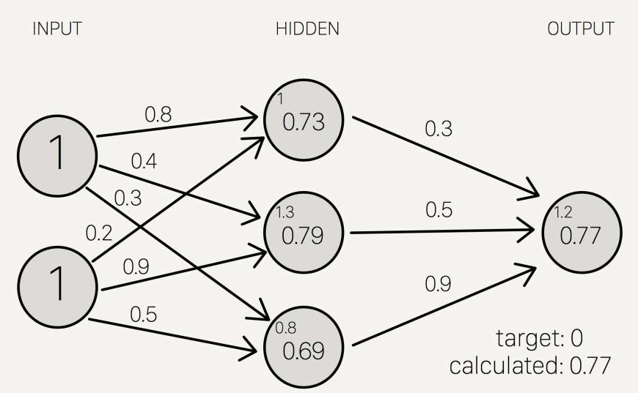
Final Results 0.77 but desired outcome is 0

Slide 49
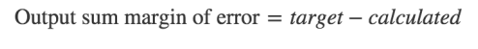
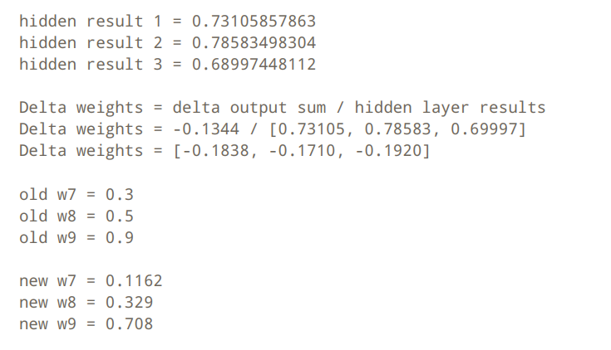
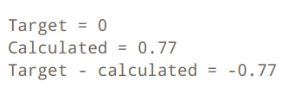
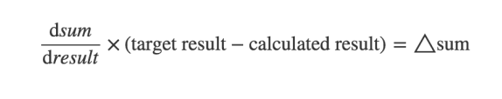
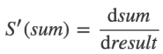
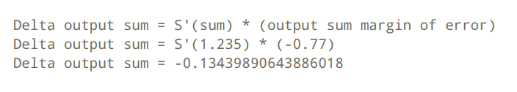
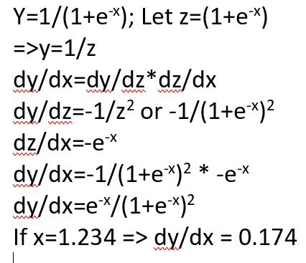
Backward Propagation – Change the weight (optional)
Step 3 Change the weight
Step 1 Margin of Error
Slide 119 Note: 2
From previous sum before activation function
-0.1344/0.734105=-0.1838
1.235 Slide 119 Note: 1
0.3-0.1838=0.1162
Step 2 Delta
S’ Function
0.174*(-0.77)=-0.13439

Slide 50
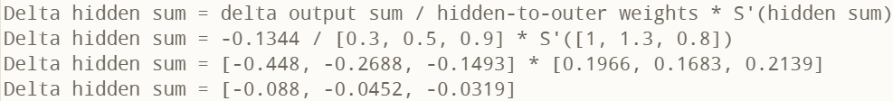
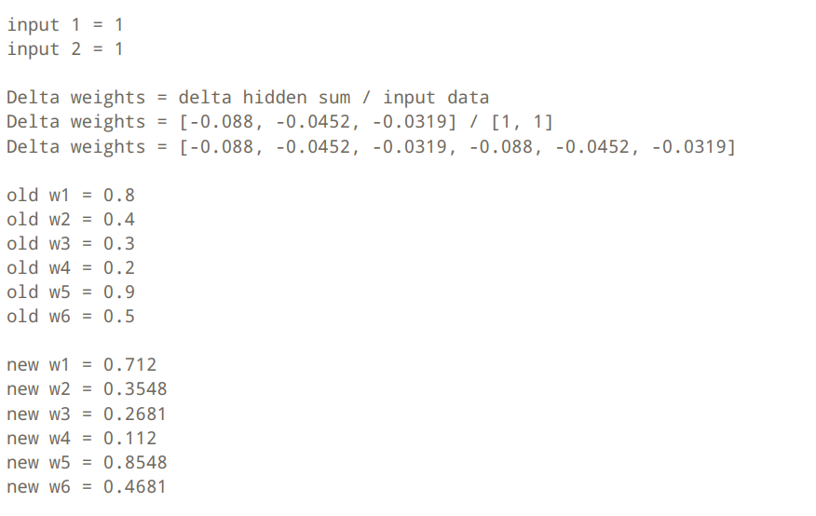
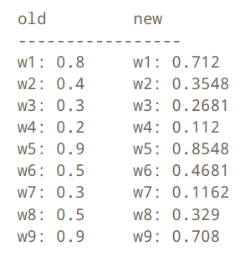
Hidden Layer Weight (optional)
Slide 118, Note: 3
Step 4 Delta
Step 5 Change the weight
-0.1344/0.3=-0.448
0.8-0.088=0.712

Slide 51
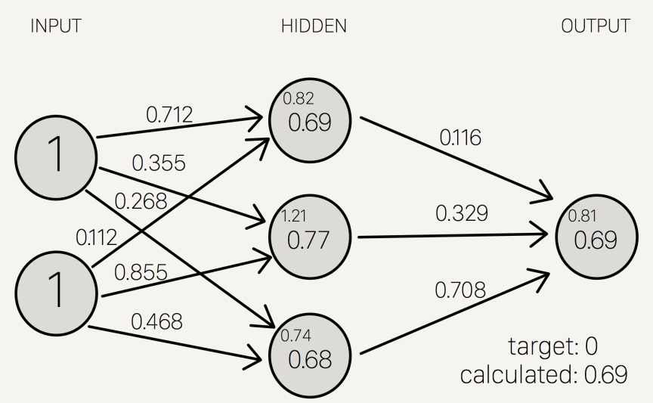
Next Iteration : Error Drop from 0.77 to 0.69
Backward Propagation

Slide 52
Specify Network Architecture
Select number of hidden layers
One hidden layer (SAS EM, R nnet allow only one hidden layer.)
R neuralnet and Deep Learning allows many hidden layers.
Select number of nodes in hidden layer(s)
More nodes capture complexity, but increase chances of overfit.
Set “Learning Rate”
High value reduce number of steps but risk flip flopping and cannot get close enough to the minimum error point.
Low value avoid flip flopping risk (default: 0.01) but increase number of steps necessary to reach minimum error point.
Resilient Backprog will adapt and choose different learning rate according to current situation. User need not choose learning rate.
Choose combination and activation functions at each layers

Slide 53
Advantages of Neural Network
Very low predictive error (on trainset!).
Can capture complex relationships by increasing number of hidden nodes and/or hidden layers.
No need to specify a relationship between Y and Xs.

Slide 54
Disadvantages of Neural Network
Considered a “black box” prediction machine, with no insight into relationships between inputs and outcome
No variable-selection mechanism, so you have to exercise care in selecting variables.
R neuralnet generalized weights plot can help to detect insignificant variables (to a certain extent).
Heavy computational requirements if there are many variables and many hidden layers
additional variables dramatically increase the num of weights to update.
Use more computing resource (cluster/supercomputer/Amazon web services/ Google Cloud/Microsoft Azure…)

Slide 55
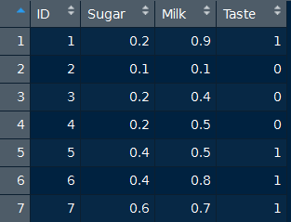
Example: Chocolate Taste Test. Y variable is categorical Taste. Taste = 1 (good) vs Taste = 0 (bad)
For now, note the range of all the X variables. To be discussed again later.
Source: Textbook ADA Vol 1, Chap 9, Section 9.4.

Slide 56
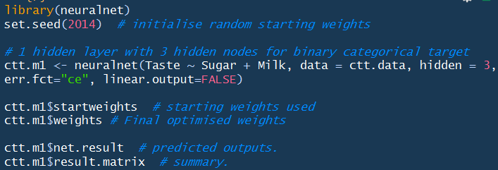
Rpackage neuralnet on chocolate taste test data
3 hidden nodes in default 1 hidden layer. To specify more than 1 hidden layer, use a vector. E.g. c(4, 2, 2) means 3 hidden layers with 4 nodes in 1st hidden layer, 2 nodes in 2nd hidden layer and 2 nodes in 3rd hidden layer.

Slide 57
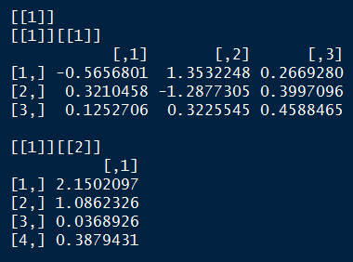
ctt.m1$startweights shows the list of randomized starting weights
Can you interpret the results?
Hint: What’s the structure of this neural network?

Slide 58
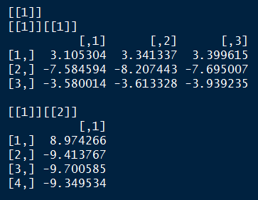
ctt.m1$weights shows the list of final optimized weights
These weights can be visualized on the neural network via the plot() function.

Slide 59
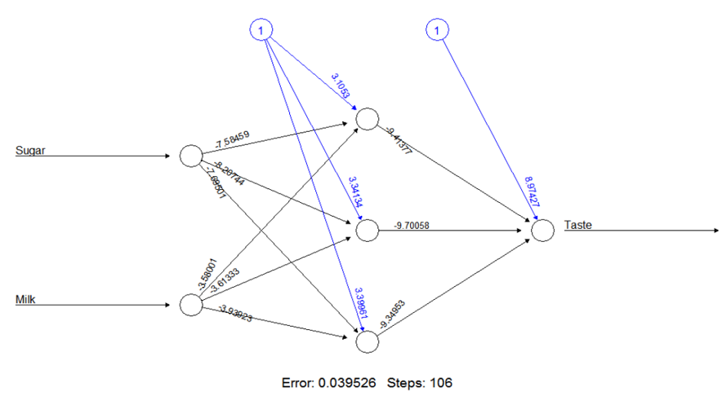
plot(ctt.m1) to view the final weights on the Neural Network diagram
Source: Textbook ADA Vol 1, Chap 9, Figure 9.2.
Notes:
Q: Write down activation functions in each node.

Slide 60
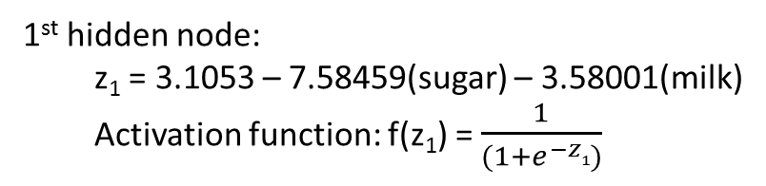
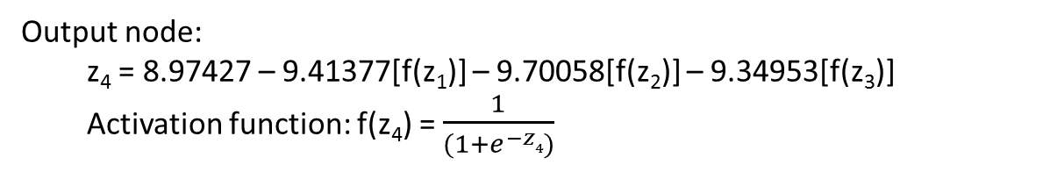
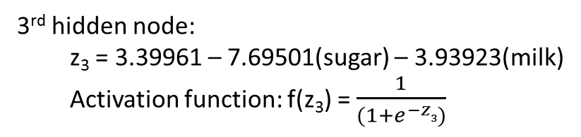
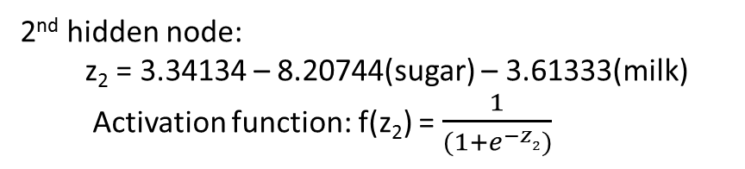
Q: What are the activation functions in each hidden node and output node?
1st hidden node:
z₁ = 3.1053 – 7.58459(sugar) – 3.58001(milk)
Activation function: f(z₁) = $\frac{1}{(1+e^{−z1})}$
2nd hidden node:
z₂ = 3.34134 – 8.20744(sugar) – 3.61333(milk)
Activation function: f(z₂) = $\frac{1}{(1+e^{−z2})}$
3rd hidden node:
z₃ = 3.39961 – 7.69501(sugar) – 3.93923(milk)
Activation function: f(z₃) = $\frac{1}{(1+e^{−z3})}$
Output node:
z₄ = 8.97427 – 9.41377[f(z₁)] – 9.70058[f(z₂)] – 9.34953[f(z₃)]
Activation function: f(z₄) = $\frac{1}{(1+e^{−z4})}$
Notes:
What happens if Y is (a) continuous or (b) multi-categorical instead of binary?

Slide 61


ctt.m1$net.result shows the model predicted value for each cases in the trainset
Q: What's the meaning of these numbers?
Ans: Logistic function values that serve as P( Y = 1) for each of the 7 cases in the trainset.

Slide 62

ctt.m1$result.matrix shows summary of results and final weights in all the paths.
Note: Bias node is aka Intercept node.

Slide 63

Demo: Infert dataset in Base R (248 observations)
Num of births
1: Infertile;
0: Not infertile.
Source: infert.R
?infert to view documentation
Objective: Predict Infertility risk based on age, births and abortions.

Slide 64


Normalization of input age and parity

Slide 65



Create Dummy Variable for induce and spontaneous

Slide 66
Neuralnet

Slide 67


Slide 68


Results

Slide 69

Results
114 out of 248

Slide 70

Weight

Slide 71

Generalized Weight, why important?
248 rows

Slide 72

What does this mean? Less spread the dot is better, less variance. Parity1 is good. Spontaneous 1 is no good.

Slide 73

Prediction

Slide 74

Final Results

Slide 75



Using nnet

Slide 76
Exercise 1
Change independent, variable, size and maxit
m4 <- nnet(case~age1+parity1+induced+spontaneous, data=infert, size=2, maxit = 10000)
Please record the results and the parameter that gives the best result.

Slide 77
Exercise 2 (3%)
Try the Diabetes data

Slide 78
Exercise 2 (Optional)
Run MLP Iris (dropbox)
Try on diabetes
Try on credit card default
What is the accuracy

Slide 79
Summary
Neural networks can be used for Categorical Y or Continuous Y.
Can capture a very flexible/complicated relationship between the outcome and a set of predictors.
The network “learns” and updates its model iteratively as more data are fed into it. Good for sequential learning.
Major danger: overfitting.
Good predictive performance, but “black box” in nature.
R neuralnet can only accept numeric variables. No categorical variables. Thus, need to manually create dummy variables.
R nnet can accept numeric or categorical variables. But remember to check and set the correct type [e.g. factor(x)]. Else the wrong default algorithm may be applied and you get nonsense results.

Slide 80
Check Your Understanding
Neural Network Algorithm

Slide 81
Reading Material (Optional)
Shwartz https://www.dropbox.com/s/ed9s6zyrtjgc7dk/Shwartz.pdf?dl=0
Interview Question: https://www.simplilearn.com/tutorials/deep-learning-tutorial/deep-learning-interview-questions
Video
https://www.youtube.com/watch?v=aircAruvnKk&t=585s
https://www.youtube.com/watch?v=1BZm5RAljn0

Slide 82
Discussion
Form your group

Slide 83
Thank You

Slide 84
Optional

Slide 85
Dataset
Idx
1
2
3
4
5
6
7
Weight | Height | Gender (Target)
71 | 170 | M
68 | 169 | M
66 | 168 | M
50 | 153 | F
58 | 164 | F
72 | 167 | F
62 | 167 | F

Slide 86
Gini Index Example: Weight >= 65 In practice, there is a heuristic algorithm to find the best split (example 65). Example of heuristic can start from medium and shift right or left. Sometimes it may be local minimum may not be global minimum. It does not matter as this is only the trainset and global minimum may be overfit.
Baseline of Split: Weight has 4 instances (4/7) where it’s equal >=65 and 3 instances (3/7) when it’s less than 65.
For Weight >= 65 & Class == M: 3 / 4 instances have class equal to M.
For Weight >= 65 & Class == F: 1 / 4 instances have class equal to F.
Gini Index here is 1-((3/4)^2 + (1/4)^2) = 0.5
For Weight < 65 & Class == M: 0 / 3 instances have class equal to M.
For Weight < 65 & Class == F: 3 / 3 instances have class equal to F.
Gini Index here is 1-((0/3)^2 + (3/3)^2) = 0
We then weight and sum each of the splits based on the baseline / proportion of the data each split takes up.
4/7 * 0.5 + 3/7 * 0 = 0.285714

Slide 87
Gini Index Example: Height >= 165
Baseline of Split: Height has 5 instances (5/7) where it’s equal >=165 and 2 instances (2/7) when it’s less than 165.
For Height >= 165 & Class == M: 3 / 5 instances have class equal to M.
For Height >= 165 & Class == F: 2 / 5 instances have class equal to F.
Gini Index here is 1-((3/5)^2 + (2/5)^2) = 0.8
For Height < 165 & Class == M: 0 / 2 instances have class equal to A.
For Var2 < 165 & Class == B: 2 / 2 instances have class equal to B.
Gini Index here is 1-((0/2)^2 + (2/2)^2) = 0
We then weight and sum each of the splits based on the baseline / proportion of the data each split takes up.
5/7 * 0.8 + 2/7 * 0 = 0.571429

Slide 88
Based on these results, you would choose Weight>=65 as the first split since its weighted Gini Index is smallest. The next step would be to take the results from the split and further partition. Let’s take the 4 / 7 records and try working with an Information Gain Split.
Index 1,2,3,6 → Impure
Index 4,5,7 → Already pure

Slide 89
Dataset (next iteration)
Idx
1
2
3
4
5
6
7
Weight | Height | Gender (Target)
71 | 170 | M
68 | 169 | M
66 | 168 | M
50 | 153 | F
58 | 164 | F
72 | 167 | F
62 | 167 | F

Slide 90
Gini Index Example: Height >= 165
Baseline of Split: Height has 4 instances (3/4) where it’s equal >=165 and 1 instances (1/4) when it’s less than 165.
For Height >= 165 & Class == M: 3/3 instances have class equal to M.
For Height >= 165 & Class == F: 0/3 instances have class equal to F.
Gini Index here is 0
For Height < 165 & Class == M: 0/1 instances have class equal to M.
For Height < 165 & Class == F: 1/1 instances have class equal to F.
Gini Index here is 0
We then weight and sum each of the splits based on the baseline / proportion of the data each split takes up.
3/4 * 0 + 1/4 * 0 = 0

Slide 91
Result
Root Node
Weight >= 65
GINI: 0.285714
Yes
No
Height >= 165
GINI: 0
Female
Index 4,5,7
Yes
No
Male
Female
Male
Index 1,2,3
Female
Index 6

Slide 92
Multiple linear regression
Key outcomes:
Gradient descent
Sigmoid calculation

Slide 93
Dataset
Weight | Height | Gender (Target)
71 | 170 | M
68 | 169 | M
66 | 168 | M
50 | 153 | F
58 | 164 | F
72 | 167 | F
62 | 167 | F

Slide 94
Dataset (normalised – min max scalar)
Weight | Height | Gender
71 | 170 | M
68 | 169 | M
66 | 168 | M
50 | 153 | F
58 | 164 | F
72 | 167 | F
62 | 167 | F
Weight | Height | Gender
0.955 | 1. | M
0.818 | 0.888 | M
0.727 | 0.833 | M
0 | 0. | F
0.364 | 0.611 | F
1 | 0.778 | F
0.545 | 0.778 | F

Slide 95

Scatterplot (best fit, probably)

Slide 96


Gradient descent (Assume no bias) Ideal Coefficient --> 1.0741 (Weight) -0.7026 (Height)
1/(1+e^-1.2074)=0.769839
2*0.955-0.7026*1=1.2074
Assume that we randomly initialize weights as 2 (Weight) and -0.7026 (Height)
Learning rate = 0.2/m = 0.2/7
Weight | Height | R | Sigmoid
0.955 | 1. | 1.2074 | 0.769839
0.818 | 0.888 | 1.012091 | 0.733429
0.727 | 0.833 | 0.868734 | 0.704482
0 | 0. | 0 | 0.5
0.364 | 0.611 | 0.298711 | 0.574127
1 | 0.778 | 1.453377 | 0.810518
0.545 | 0.778 | 0.543377 | 0.632598

Slide 97
Gradient descent (Assume no bias) Ideal Coefficient --> 1.0741 (Weight) -0.7026 (Height)
Assume that we randomly initialize weights as 2 (Weight) and -0.7026 (Height)
Learning rate = 0.2/m = 0.2/7
Weight | Height | R | Sigmoid | Y Pred | Y True
0.955 | 1. | 1.2074 | 0.769839 | 1 | 1
0.818 | 0.888 | 1.012091 | 0.733429 | 1 | 1
0.727 | 0.833 | 0.868734 | 0.704482 | 1 | 1
0 | 0. | 0 | 0.5 | 1 | 0
0.364 | 0.611 | 0.298711 | 0.574127 | 1 | 0
1 | 0.778 | 1.453377 | 0.810518 | 1 | 0
0.545 | 0.778 | 0.543377 | 0.632598 | 1 | 0
Wrong
> 0.5 will be predicting 1

Slide 98

Gradient descent (Assume no bias) Ideal Coefficient --> 1.0741 (Weight) -0.7026 (Height)
Assume that we randomly initialize weights as 2 (Weight) and -0.7026 (Height)
Learning rate = 0.2/m = 0.2/7
Weight | Height | R | Sigmoid | Y Pred | Y True
0.955 | 1. | 1.2074 | 0.769839 | 1 | 1
0.818 | 0.888 | 1.012091 | 0.733429 | 1 | 1
0.727 | 0.833 | 0.868734 | 0.704482 | 1 | 1
0 | 0. | 0 | 0.5 | 1 | 0
0.364 | 0.611 | 0.298711 | 0.574127 | 1 | 0
1 | 0.778 | 1.453377 | 0.810518 | 1 | 0
0.545 | 0.778 | 0.543377 | 0.632598 | 1 | 0
Cost function (binary cross entropy)
See Jupyter notebook (problem set for more detail)
P(yi) = result of each individual sigmoid
Cost
= (0.7698(1) + (0)lg(1-0.7698))
+ (0.7334(1) + (0)lg(1-0.7334))
+ …
+ (0.6325(0) + (1)(lg (1-0.6325)))
= 0.73339589
Note Yi is Y True

Slide 99
Gradient descent (Assume no bias) Ideal Coefficient --> 1.0741 (Weight) -0.7026 (Height)
Assume that we randomly initialize weights as 2 (Weight) and -0.7026 (Height)
Learning rate = 0.2/m = 0.2/7
Weight | Height | R | Sigmoid | Y True | Sigmoid(X dot params) - y
0.955 | 1. | 1.2074 | 0.769839 | 1 | -0.23016
0.818 | 0.888 | 1.012091 | 0.733429 | 1 | -0.26657
0.727 | 0.833 | 0.868734 | 0.704482 | 1 | -0.29552
0 | 0. | 0 | 0.5 | 0 | 0.5
0.364 | 0.611 | 0.298711 | 0.574127 | 0 | 0.574127
1 | 0.778 | 1.453377 | 0.810518 | 0 | 0.810518
0.545 | 0.778 | 0.543377 | 0.632598 | 0 | 0.632598
Gradient
= X.T dot (sigmoid(X dot params) - y))
= -0.23016 * [0.955,1]
+ -0.26657 * [0.818,0.888]
+ -0.29552 * [0.727,0.833]
+ ….
= [0.711565, 0.760493]
New weights
= [2, -0.7026] – 0.2/7*[0.711565, 0.760493]
= [1.97966975, -0.72430969]

Slide 100
Gradient descent (Assume no bias) Ideal Coefficient --> 1.0741 (Weight) -0.7026 (Height)
Assume that we randomly initialize weights as 2 (Weight) and -0.7026 (Height)
Learning rate = 0.2/m = 0.2/7
Weight | Height | R | Sigmoid | Y True | Sigmoid(X dot params) - y
0.955 | 1. | 1.2074 | 0.769839 | 1 | -0.23016
0.818 | 0.888 | 1.012091 | 0.733429 | 1 | -0.26657
0.727 | 0.833 | 0.868734 | 0.704482 | 1 | -0.29552
0 | 0. | 0 | 0.5 | 0 | 0.5
0.364 | 0.611 | 0.298711 | 0.574127 | 0 | 0.574127
1 | 0.778 | 1.453377 | 0.810518 | 0 | 0.810518
0.545 | 0.778 | 0.543377 | 0.632598 | 0 | 0.632598
Gradient
= X.T dot (sigmoid(X dot params) - y))
= [0.711565, 0.760493]
New weights
= [2, -0.7026] – 0.2/7*[0.711565, 0.760493]
= [1.97966975, -0.72430969]
Repeat the procedure with new weights:
Numerical calculation for first 5 weights updates:
[ 2. , -0.7026 ]
, [ 1.97966975, -0.72430969]
, [ 1.96016867, -0.74510308]
, [ 1.9414751 , -0.7650052 ]
, [ 1.92356658, -0.78404182]])

Slide 101

Gradient descent (Assume no bias) Ideal Coefficient --> 1.0741 (Weight) -0.7026 (Height)
Weights has changed to optimal after 1500 iterations @[[ 1.15798384] [-0.78034338]]
Weight | Height | R | Sigmoid
0.955 | 1. | 1.2074 | 0.769839
0.818 | 0.888 | 1.012091 | 0.733429
0.727 | 0.833 | 0.868734 | 0.704482
0 | 0. | 0 | 0.5
0.364 | 0.611 | 0.298711 | 0.574127
1 | 0.778 | 1.453377 | 0.810518
0.545 | 0.778 | 0.543377 | 0.632598

